Slide 1
Lab Course Cognitive Systems: Depth & Bounding Box Prediction
Interim Presentation
WS 17/18
26.01.2018
S. Aklanoglu, J. Schuck, Y. El himer, F. Retkowski

Slide 2
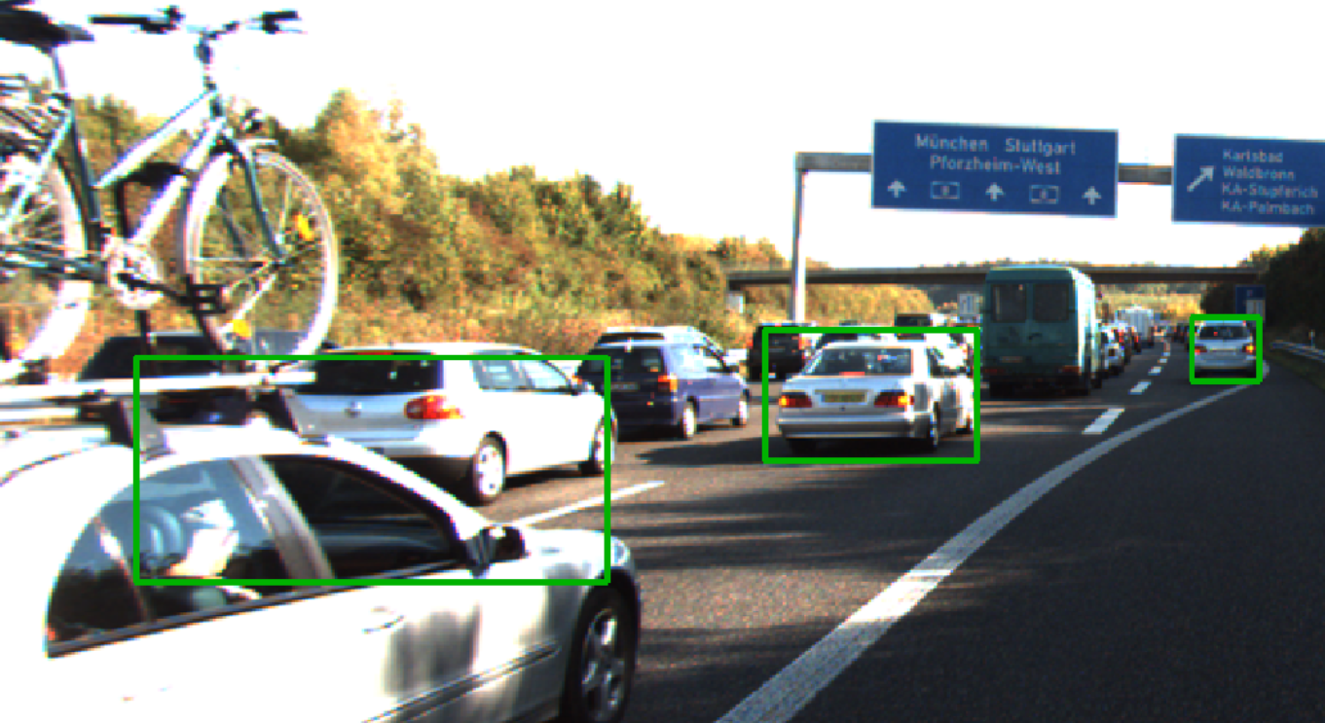
Problem Definition
Vehicle detection with CNN
Issues: poor performance for largely overlapping vehicles
Possible solution: using depth information
26.01.2018
S. Aklanoglu, J. Schuck, Y. El himer, F. Retkowski

Slide 3
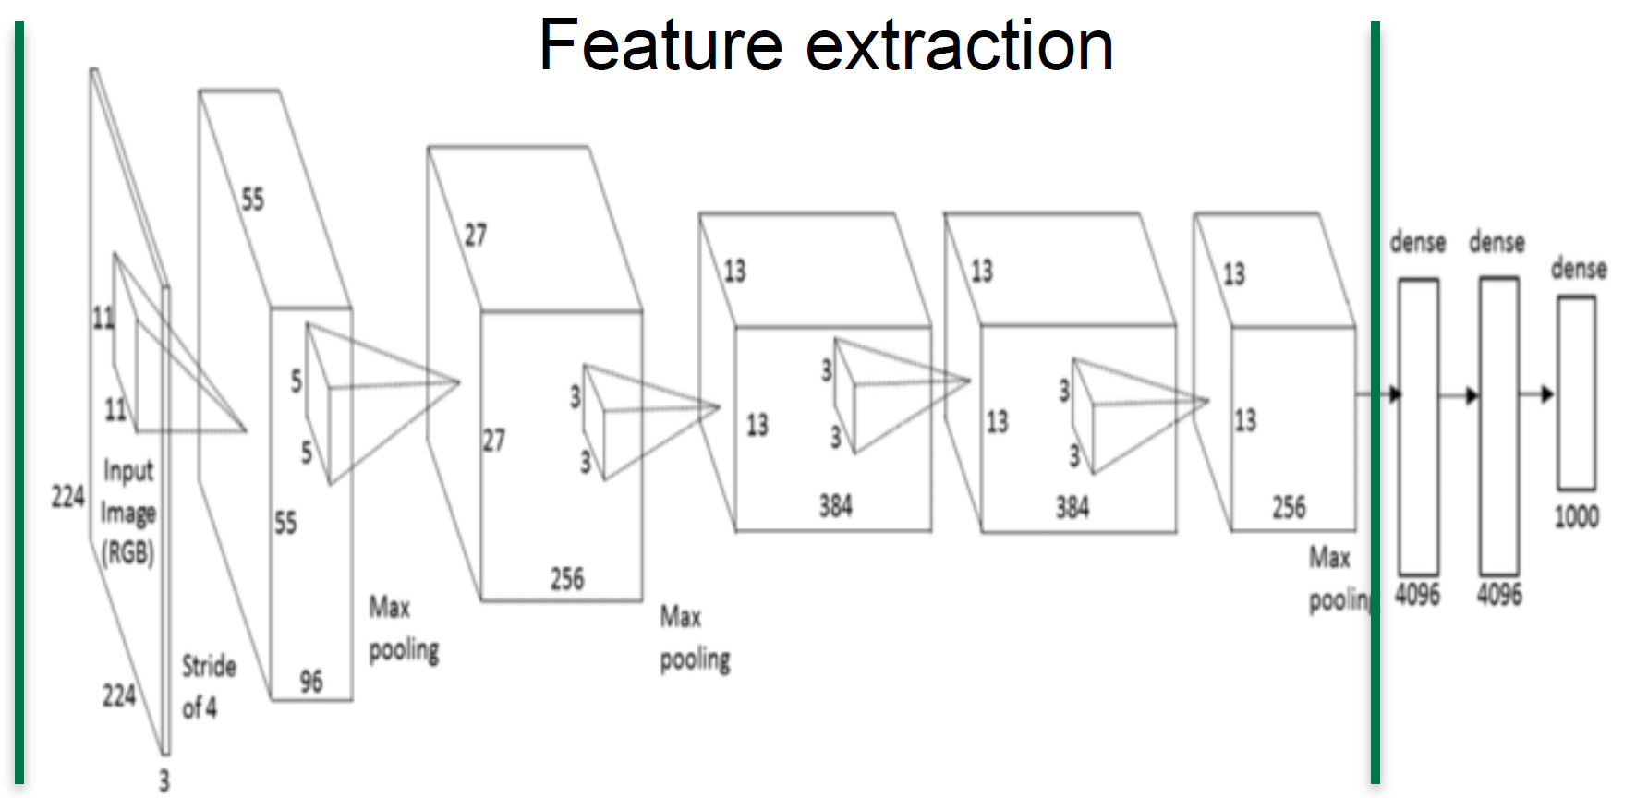
1. Concept
Learning from depth images for monocular object detection with convolutional neural networks, MA A. Lesi
DeepTLR¹ based object detection - class and bounding box regression
From FZI, Caffe based
Feature Extraction
Feature Classific.
Class & BB
AlexNet
convolution
tiling
softmax
class & bb regression
Datensatz: KITTI² , GTA V?!
¹http://ieeexplore.ieee.org/stamp/stamp.jsp?tp=&arnumber=7535408
²http://www.cvlibs.net/publications/Geiger2012CVPR.pdf
26.01.2018
S. Aklanoglu, J. Schuck, Y. El himer, F. Retkowski
1

Slide 4
1. Concept
Learning from depth images for monocular object detection with convolutional neural networks, MA A. Lesi
Joint convolution depth prediction and object detection
Against using of superpixels
Feature Extraction
Feature Classific.
Class & BB Regression
600x400x3
fc
ReLu
Dropout
Sigmoid
26.01.2018
S. Aklanoglu, J. Schuck, Y. El himer, F. Retkowski
1

Slide 5


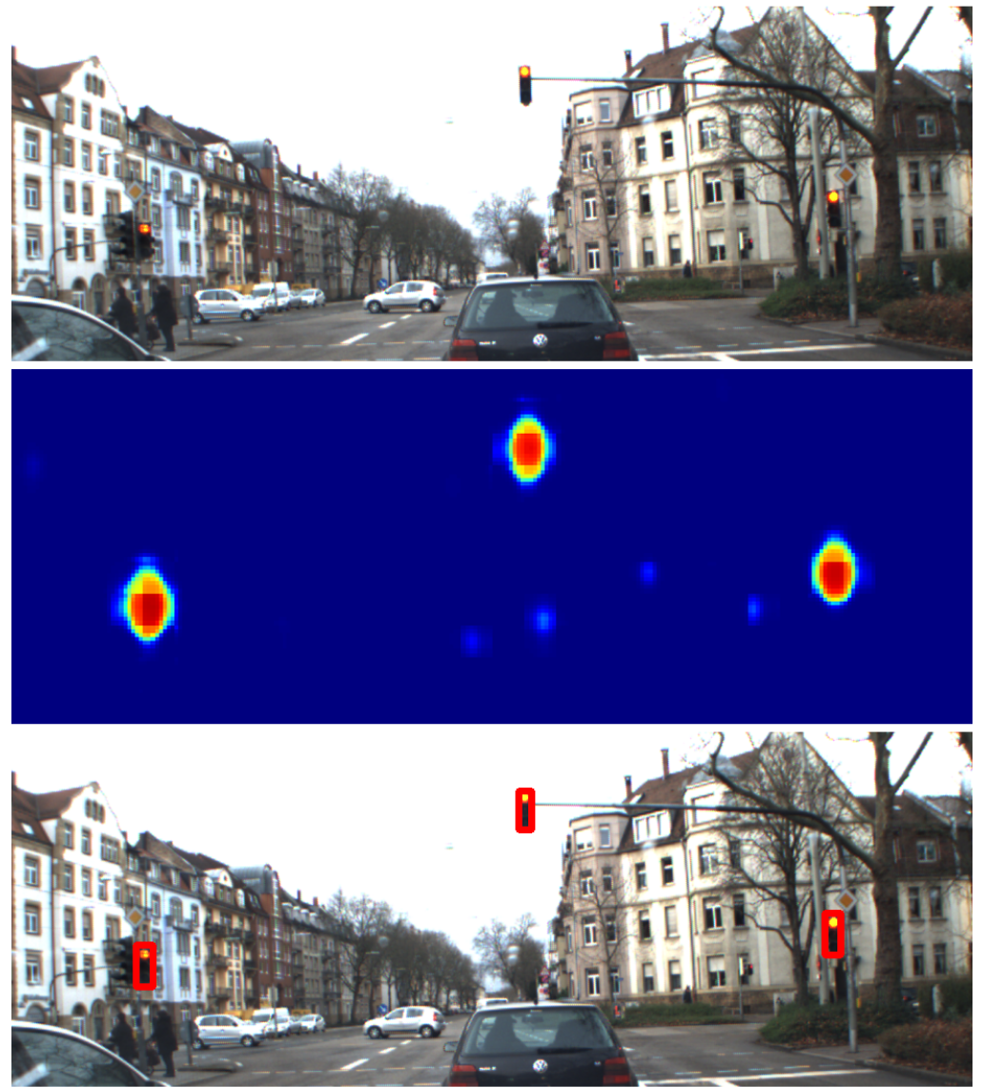

1. Concept
Learning from depth images for monocular object detection with convolutional neural networks, MA A. Lesi
Current State:
Caffe running
Data processing & augmentation
LMDB creation
First training on KITTI
Evaluation routines
Using code from M. Weber and A. Lesi
No modifications on framework planned
Inference Speed: 20 – 45 ms
26.01.2018
S. Aklanoglu, J. Schuck, Y. El himer, F. Retkowski
1

Slide 6
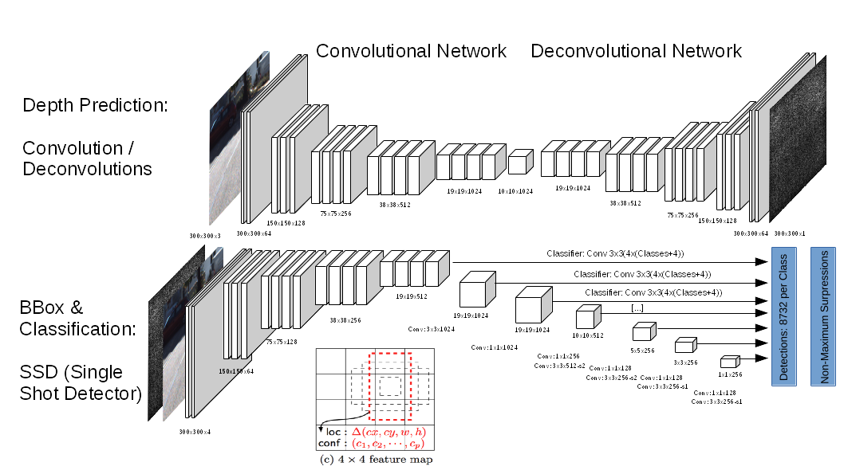
2. Concept
Deeper Depth Prediction with Fully Convolutional Residual Networks, Laina et al.
+ SSD: Single Shot MultiBox Detector, Liu et al.
2 Stages: DeconvNet for depth prediction + SSD detector
300x300x3
300x300x3
26.01.2018
S. Aklanoglu, J. Schuck, Y. El himer, F. Retkowski
1

Slide 7
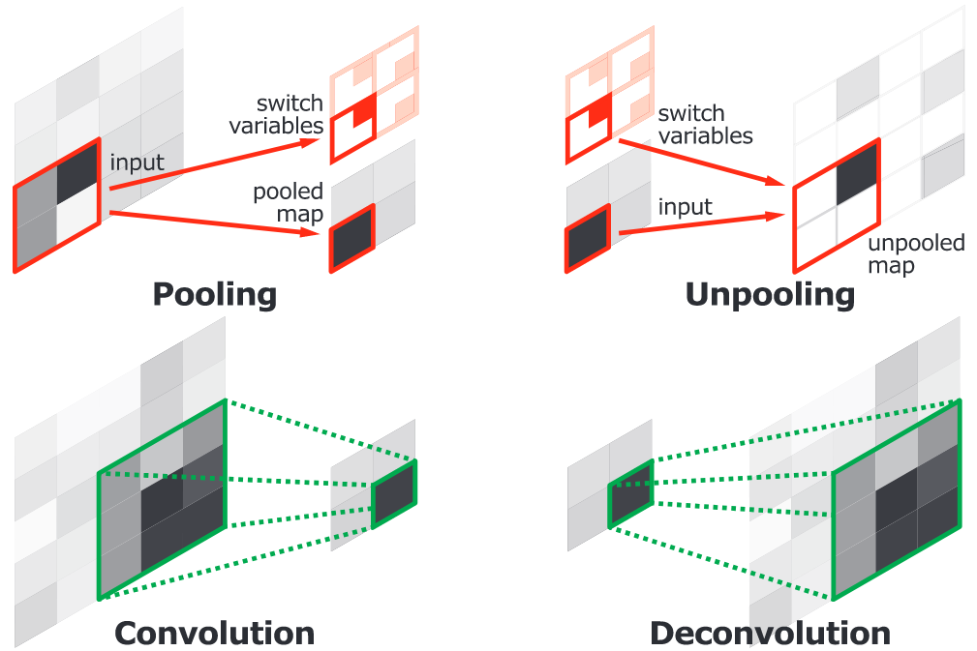
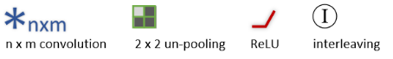
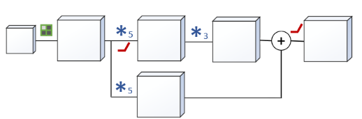
2. Concept
Deeper Depth Prediction with Fully Convolutional Residual Networks, Laina et al.
+ SSD: Single Shot MultiBox Detector, Liu et al.
Pooling: filter noisy activations in lower layers with single value representation
spatial information lost, critical for localization
Using pooling and unpooling layers
Unpooling: Reverse operation of pooling
increases the spatial resolution of feature maps
Deconvolution: Reverse operation of convolution
single input activation with multiple outputs
enlarged and dense activation map
Up-projection: adds a 3x3 convolution after the Unpooling and a projection (=res-blocks) connection from the lower resolution feature map to the result
high-level info efficiently passed forward
increase feature map sizes
26.01.2018
S. Aklanoglu, J. Schuck, Y. El himer, F. Retkowski
1

Slide 8
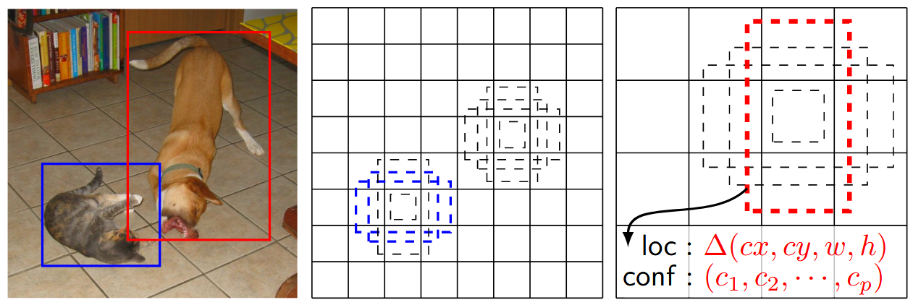
2. Concept
Deeper Depth Prediction with Fully Convolutional Residual Networks, Laina et al.
+ SSD: Single Shot MultiBox Detector, Liu et al.
Object detection based on VGG
Uses predefined anchor boxes with different sizes and ratios
For every box will be calculated if object is in box or near at it, the object class and the bb
Unused boxes will be deleted and non-maximum suppression is used to obtain final boxes
Faster than YOLO!
26.01.2018
S. Aklanoglu, J. Schuck, Y. El himer, F. Retkowski
1

Slide 9

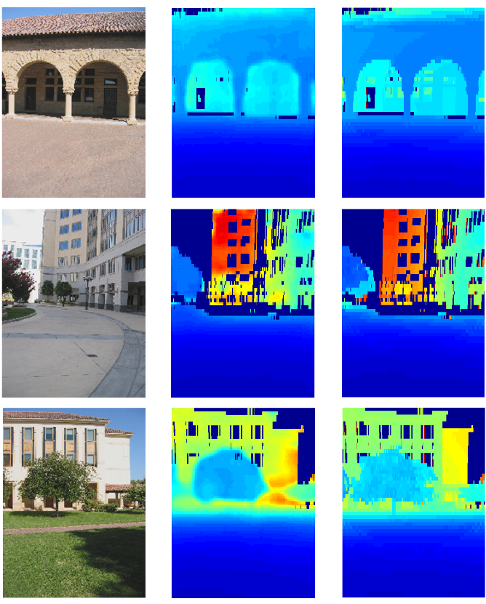

2. Concept
Deeper Depth Prediction with Fully Convolutional Residual Networks, Laina et al.
+ SSD: Single Shot MultiBox Detector, Liu et al.
Current State:
Up and running isolated frameworks
When and where combine outputs – inputs?!
Data processing & augmentation
First training on KITTI
Evaluation routines
Both networks use VGG for feature extraction
Both are implemented in Tensorflow
Inference Speed:
DeconvNet: ~200 ms on CPU, SSD: ~22 ms on Titan X
26.01.2018
S. Aklanoglu, J. Schuck, Y. El himer, F. Retkowski
1

Slide 10
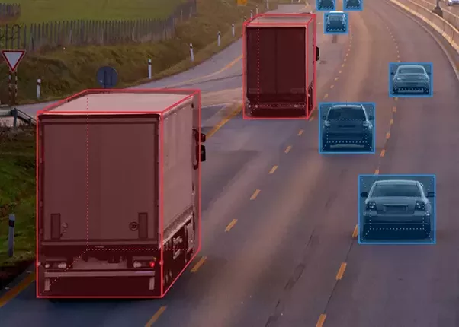
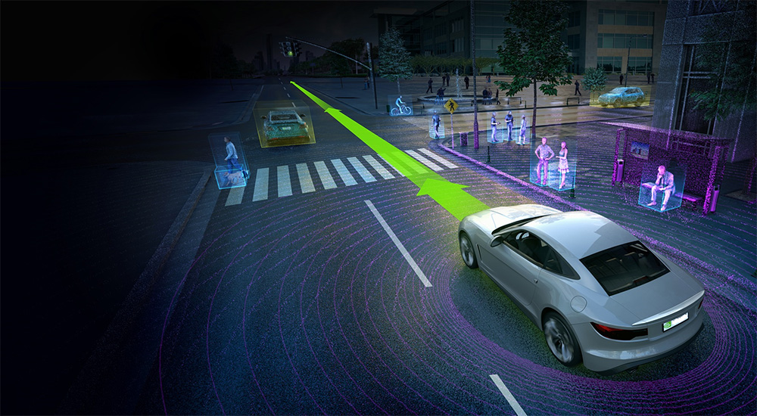
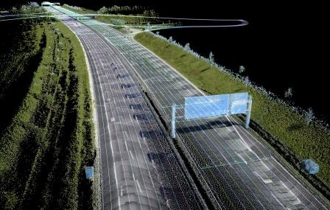
Questions?

